Slide 1
Used Cars Price Prediction
Satu Pole
Intern- Flip Robo Technologies

Slide 2
Contents
Introduction
Problem Statement
Introduction to dataset
Data cleaning,treating duplicates and null values
Visualization using plots
Treating Outliers and Skewness and Encoding
Algorithms used
Model performance
Key metrics used to understand model
Saving model
Conclusion

Slide 3
Introduction
Car price prediction is a way of understanding the attributies due to which the resale value of car changes. For example some people prefer automatic transmission over manual, hence prices of automatic transmission cars goes higher.
These kinds of machine learning models will help resellers/dealers and also help people to sell and buy their cars according to the market value.

Slide 4
Problem statement
With the covid 19 impact in the market, we have seen lot of changes in the car market. Now some cars are in demand hence making them costly and some are not in demand hence cheaper. One of our clients works with small traders, who sell used cars. With the change in market, our client is facing problems with their previous car price valuation machine learning models.
Hence we need to provide new machine learning models which are based on revised attributes and with respect to new prices as are in market.
This model will provide approximate prices for used cars which will help car dealers to sell particular car. This price prediction will use previously mentioned factors that help in devising car price.

Slide 5
Introduction to dataset
The data which was later transformed into csv file was scrapped from www.cars24.com website. The scrapped data included columns such as brand, model, year, transmission, kilometers driven, owner, fuel type, price and location.
The datatype was object type for all columns except year column which was showing integer.
Since we had to predict prices for the cars, hence price column was considered as ‘label’ or target column.
The scrapped data contained 7019 rows and 11 columns of which 2 columns were dropped which showed only index number for rows.

Slide 6
EDA- Data Cleaning, treating duplicates and null values
Upon checking for duplicates the dataset showed 1219 duplicate entries which were later removed leaving only 5800 rows in dataset.
The model column had names of cars in form of “['Grand', 'i10']”. In this case the outer [] brackets , single inverted commas and comma within 2 words had to be removed as part of data cleaning for whole column. This was done using replace method.
For kms_driven column, using replace method its comma present and km letters were removed.
As specified above using replace method, rupee sign was removed from prices column.

Slide 7
EDA- Data Cleaning, treating duplicates and null values contd.
On checking dataset for presence of null values, it showed that there were 546 null values in transmission column and 426 in price column.
Since this is fragile data which means if I input mode of transmission column (I.e. manual) and if null values are present in actual automatic car, then the price prediction would have been lower instead of higher, making a faulty model.
Hence I did not used any inputting methods and dropped all the null values from dataset. After dropping null values the dataset shape was 4921 rows and 9 columns.
Later the datatype of kms_driven and price columns were changed from object to integer type.

Slide 8
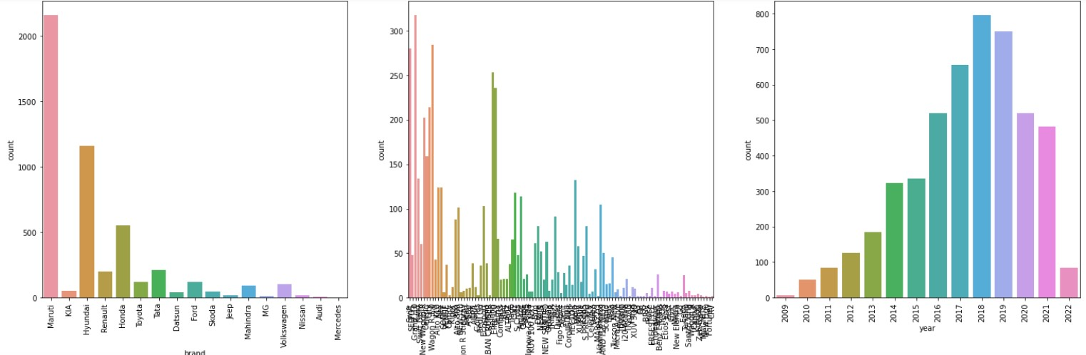
EDA - Visualizations
Observations:
Incase of car brands, The most number of cars that are for sale are from Maruti brand while least are from Mercedes brand.
Incase of model of cars, Grand i10 is the most available car for sale followed by Wagonr and swift.
incase of years of cars, most cars for sale are from the year 2018 followed by 2019 and 2017. The least cars for sale are from the year 2009.

Slide 9
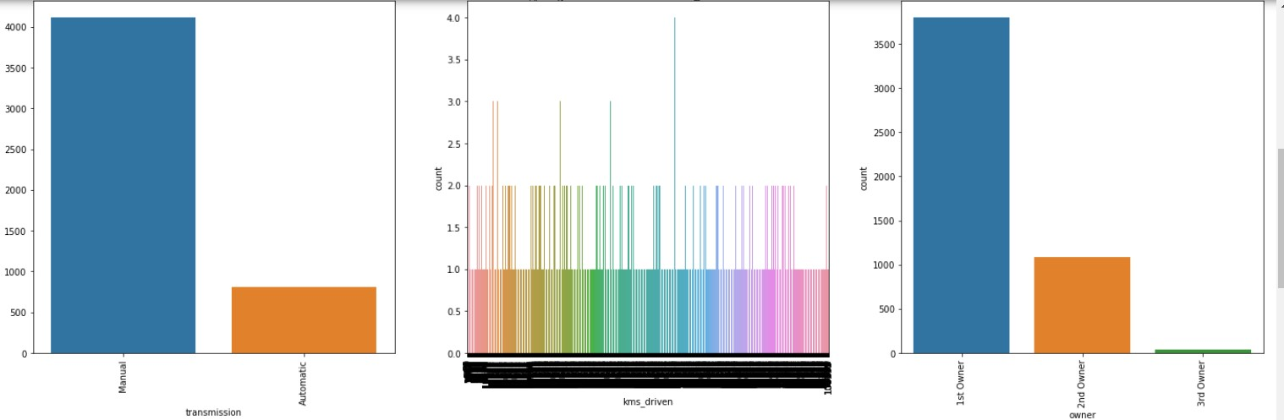
EDA - Visualizations contd.
Observation:
Incase of transmission, most number of cars for sale are with manual transmission while very less cars are with automatic transmission.
Most number of cars are owned by single person, while approx. 1000 cars had 2 owners in its lifetime while some cars were owned by 3 people.

Slide 10
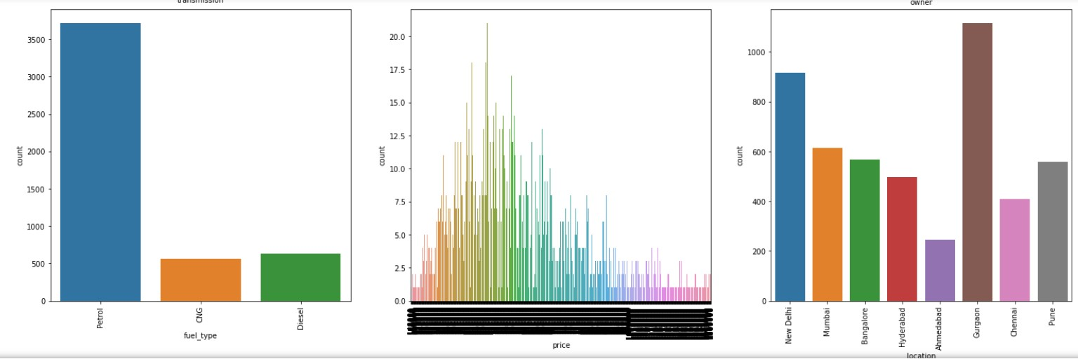
EDA- Visualizations contd.
Observations:
Most number of used cars for sale run on petrol while very less number of cars for sale run on cng and diesel.
Most number of cars for sale are from Gurgaon region while less number of cars for sale are from Ahmdedabad region.

Slide 11
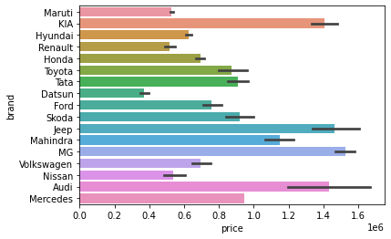
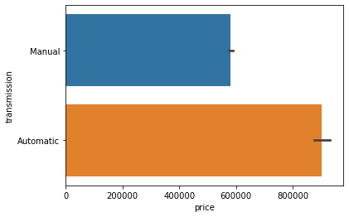
EDA- Visualizations contd.
Observations:
It can be seen from the plot that though as seen earlier Maruti has highest number of cars for sale but their unit car price is low compared to other brands. MG brand has their cars priced higher for resale, followed by Jeep, Audi and Kia.
Automatic cars are priced higher compared to manual transmission cars.

Slide 12
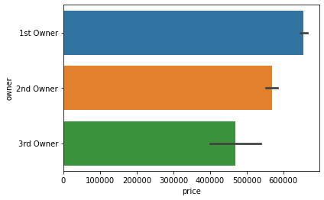
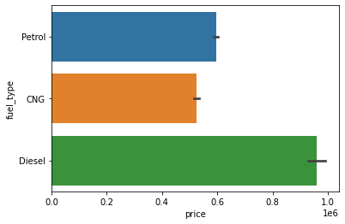
EDA- Visualizations contd.
Observations:
the cars that are owned by 3 owners are priced lower compared to cars owned by 2 and single owner.
The diesel powered cars are priced higher followed by petrol cars. The cheapest cars are with CNG fuel.

Slide 13
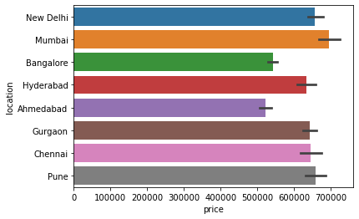
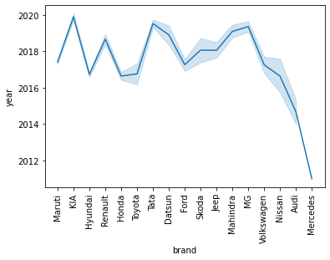
EDA- Visualizations contd.
Observations:
It can be seen from the plot that cars from Mumbai are priced higher compared to other cities or locations.
It can be seen that Maruti, Tata and MG brand cars for sale are mostly new cars while cars from brands like Nissan, Audi and Mercedes are older ones.

Slide 14
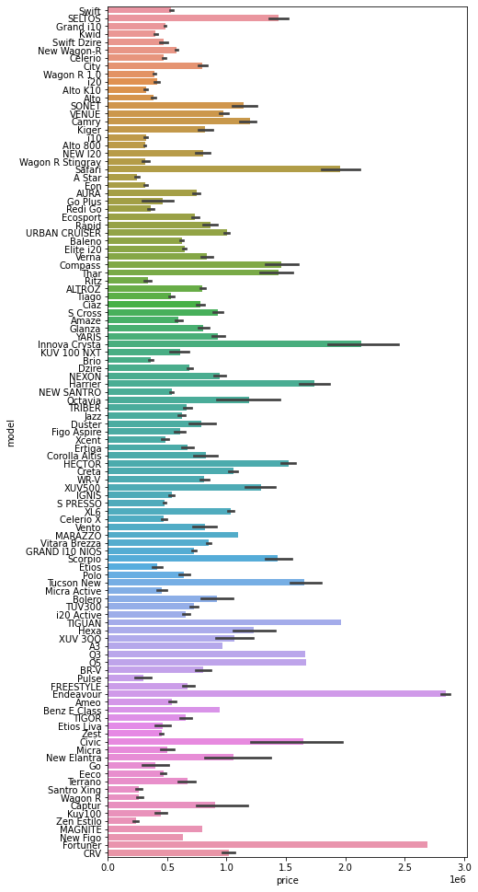
EDA- Visualizations contd.
Observation:
It is seen that Endeavour, Fortuner, Innova Crysta and Safari cars are priced higher compared to other cars. These are actually big premium SUV cars.
It is also seen that price of smaller hatchback cars are priced low.

Slide 15
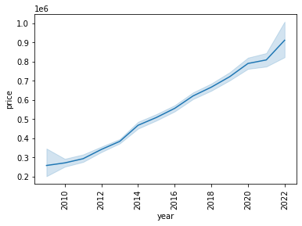
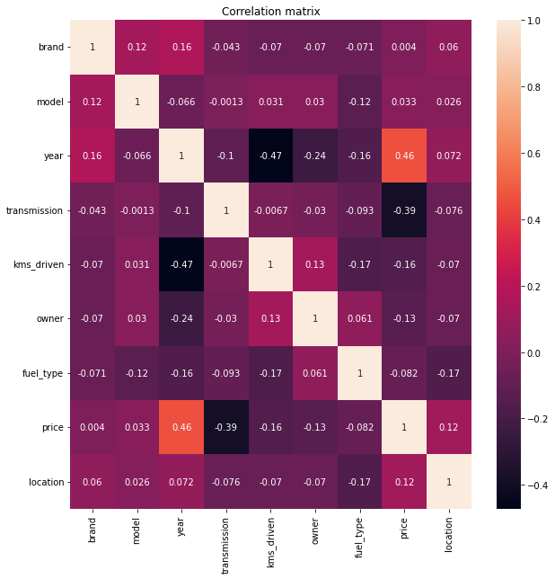
EDA- Visualizations contd.
Observations:
It can be seen that the cars which are new are priced higher compared to cars that are old. The oldest cars from year 2009 are priced lowest
The heatmap shows that no multicollinearity seen within features.

Slide 16
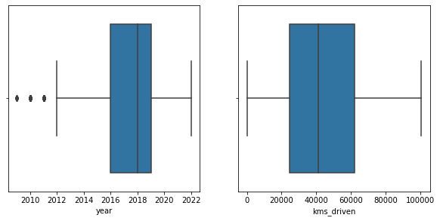
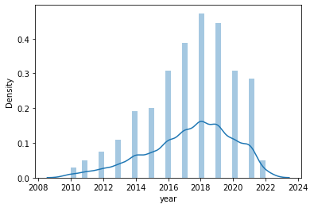
EDA- Visualizations contd.
Observations:
The boxplots plotted shows that in year column there is presence of outliers while in kms_driven column there are none.
The displot shows that data in year column was left skewed indicating presence of skewness.

Slide 17
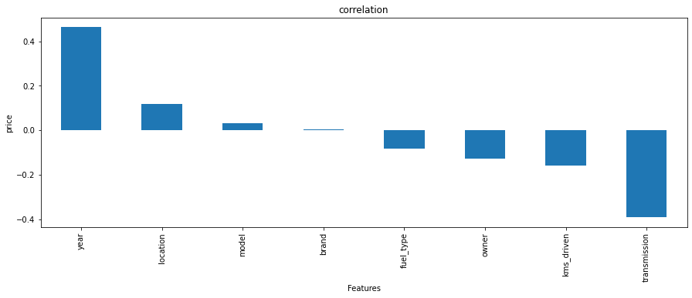
EDA- Visualizations contd.
The above graph shows the relation of features/independent variables with price of car. The above graph shows that year is highly positvely related to car price while transmission is highly negatively related to car price. The car brand column is least related to price of car.

Slide 18
EDA- Treating Outliers and Skewness and Encoding
The categorical columns present in dataset were encoded using Label Encoding method.
Further, upon checking continuous columns other than label of dataset for presence of outliers by plotting boxplots, it was seen that year column has presence of outliers. This were further removed using z-score method.
Further year column showed presence of skewness. To confirm that, distplot was plotted which showed presence of skewness. Skweness was removed using log transformation method.

Slide 19
Model Building - Algorithms used
Random Forest Regressor model.
AdaBoost Regressor model.
Decision Tree Regressor model.
Gradient Boosting Regressor model.
The best model chosen for hyperparameter tuning was Random Forest model as it had better R2 testing accuracy then other models and its RMSE value was low compared to other models.

Slide 20
Model Building- Model performance
Model Name | Training R2 Score | Testing R2 Score | Cross validation score | RMSE value
Random Forest | 98.43% | 92.98% | 90.34% | 87277.81
AdaBoost | 39.26% | 47.17% | 27.06% | 239430.56
Decision Tree | 100% | 90.47% | 83.80% | 101694.1
Gradient Boosted Tees | 84.83% | 85.45% | 81.61% | 125656.95
Tuned Random Forest | 64.27% | 69.25% | 62.27% | 182659.95
The table shows regression models training and testing R2 score alongwith metrics used to identify best model.
The table also shows the data of tuned model whose R2 scores are very low compared to original Random Forest model.

Slide 21
Model Building- Key metrics used to understand model
The key metrics used in this models are:
R2 score- This is the most important metrics in determining the accuracy of the model. It is a statistical measure that represents the goodness of fit of a regression model. The ideal value for R2 Score is 1 or 100%. The closer the value of R2 Score to 1, the better is the model fitted.
Cross validation (CV) score: This is used on models to check if the model is overfitting or not. If the testing R2 score and CV score is equal or near equal then model is said to be best fitted model or else overfit model.
RMSE(Root Mean Squared Error): This is similar to MAE but noise is exaggerated and larger error are punished. This is the main metric used in interpreting model. RMSE close or equal to zero means best model.

Slide 22
Saving model
From the previous table it can be seen that original Random Forest model is better in terms of R2 score. Cross validation score and RMSE values with repect to tuned Random Forest model.
Hence, the original model was saved as the best model for machine learning using pickle library.

Slide 23
Conclusion
The car prices are inversely proportional to age of cars which means that as the age of the cars increases their resale value decreases. This is because most of the people want to buy cars that are as new as possible so they don’t have to pay more on their servicing costs as happens for older cars.
Since the bigger and premium cars have more features present, hence these cars have higher resale value compared to small cars.
Diesel being a cheaper fuel option in India and also providing greater fuel economy plus automatic cars giving ease of driving in city as well as highway conditions. Hence cars with automatic transmission and diesel fuel type have higher resale value compared to manual and petrol cars
If the car is previously owned by 2 or 3 owners its resale values decreases compared to single owned cars. The reason according to me is that person tend to sell their car if the car is having any mechanical problems or failures. Hence the 2nd person owning the car feels the same and sells it. Hence it value decreases over the time.

Slide 24
Thank You

